Slide 1
Physical Computing
Raspberry Pi Pico and Micro-Python

Slide 2
Computer Systems - Starter
Think, pair, share
What components do all computer systems have in common?
What is the difference between a general purpose computer and an embedded system?
Notes:
Students should be able to build on prior learning to identify Input, Process, Output and Storage as common components of computing systems and that embedded systems have a single function a general purpose computer can offer a wider range of functions.
Remind students they are building up to a complete embedded system that will allow them to draw images on an output screen. This will require connecting input and output devices to the Pico. Last lesson they programmed an output device via the onboard LED. Can students recall how the output was controlled? Turning on and off the voltage of the Pin setting the Pin value to 1 & 0.

Slide 3
In this lesson you will learn
How breadboards are used as tool for prototyping with microcontrollers.
How to create simple circuits to input digital data using a push button.
How to create a sequence of instructions to control the button input

Slide 4
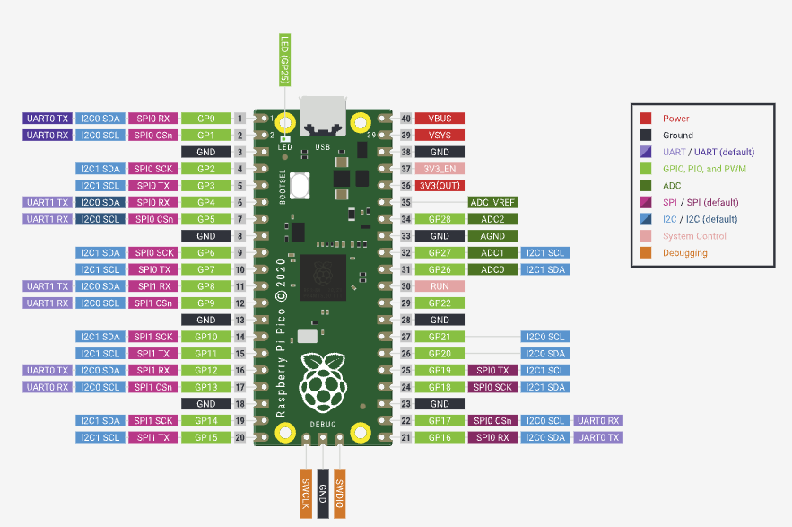
The Pico RP2040 Microcontroller
Last lesson you learnt that digital GPIO pins can be toggled on or off by passing a current through the pin
Can you recall the methods you used to turn on and off a pin on the Pico?
Notes:
led.value() led.toggle()

Slide 5
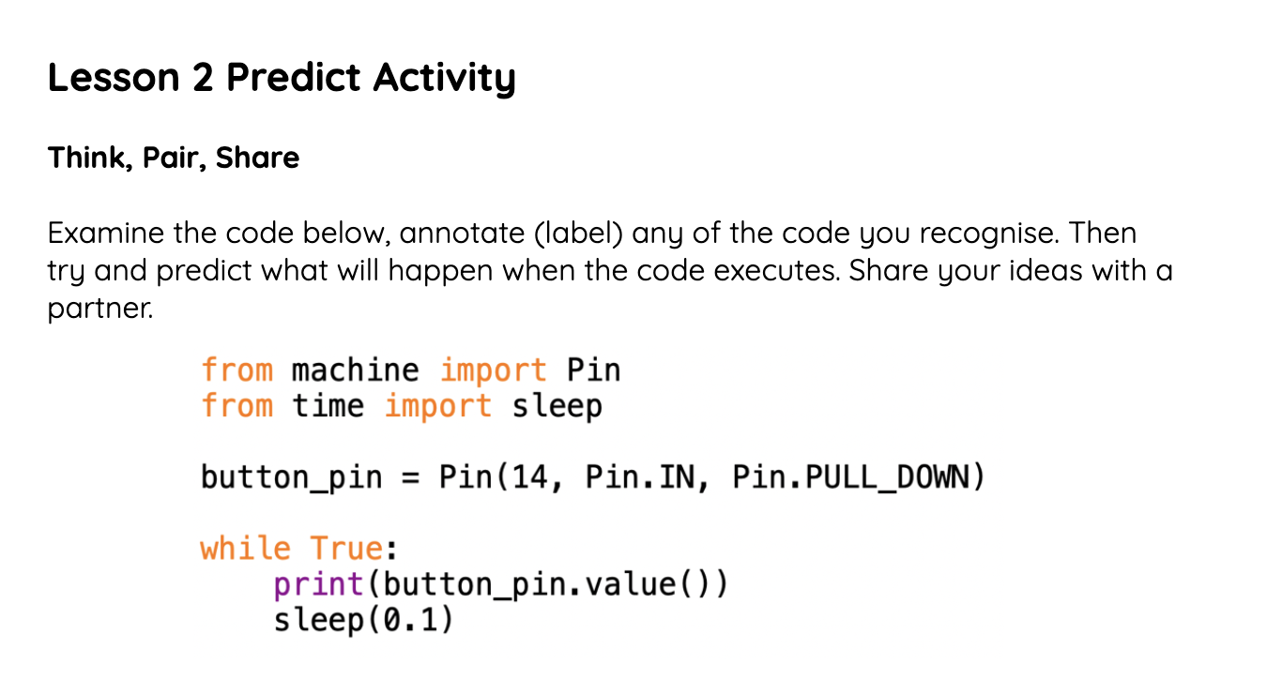
Use the worksheet Predict Activity
What will happen when the code is executed?
Do you recognise any lines of code from last lesson?
Annotate the code to show your understanding
Notes:
All students should be able to identify some code from last lesson, some students will quickly work out what will happen during execution. Once students have had time to make a prediction, execute the code and demonstrate the button result if the button press.

Slide 6
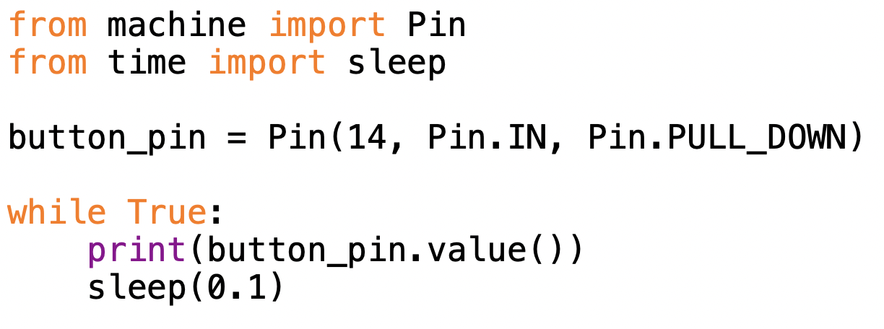
Let's examine the code
Annotate your sheet to help you later
Import the pin module from the machine library
Import the sleep function from the time library
Initialise a digital pin object and assign it to Pin 17 set this as an input pin with a PULL_DOWN
While true creates an indefinite loop
.value() is method it reads (gets) the value of the pin either 0 or 1
Sleep() function is called to create a time delay this is known as a debounce
Notes:
GPIO pins are objects. To instantiate the object we allocate it to a Pin and set as either an input PULL_UP or PULL_DOWN this pulls the voltage up to 3v or down to 0 we can then read for 0 or 1. The pins can float with a voltage anywhere between the 0 and 3v which can result in miss reads so whilst PULL_UP or DOWN is optional it is recommended to use this the default is PULL_DOWN. This means the pin is always on and awaiting an interrupt in signal
The debounce handout provides a more detailed explanation of why the sleep is required. In brief it helps prevent false readings.

Slide 7
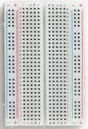
The Breadboard
Terminal Strips
Ground Rails
Power Rails
Designed to assist in prototyping the breadboard allows temporary connection to be made to pins
Bus Strips
Tie points
Notes:
It is a good idea to give students a breadboard to handle before explaining the anatomy. Taking the bottom sticky pad off a breadboard and allowing students to see inside the breadboard is another useful activity.
A breadboard is a fundamental tool used in electronics prototyping to create temporary circuits without the need for soldering. It allows engineers, hobbyists, and students to quickly build and test electronic circuits. Here's a breakdown of the anatomy of a typical breadboard:
Board Base
The main body of the breadboard is often made of plastic. It provides the structure for the board and holds the metal contact strips in place.
Terminal Strips:
- The long strips running along the sides of the breadboard are called terminal strips. These strips are typically used for power and ground connections.
Bus Strips:
- The shorter strips running perpendicular to the terminal strips are called bus strips. Each set of bus strips is usually used to connect related points in a circuit.
Rows and Columns:
The holes on the breadboard are organized into rows and columns. Each row typically consists of five holes, and there are usually multiple rows and columns.
Power Rails:
The two vertical columns on the sides of the breadboard are known as power rails. One side is often used for the positive supply voltage (Vcc), and the other side is used for ground (GND). These rails are connected internally, providing power throughout the corresponding rows.
Tie Points:
The holes in the rows and columns where components are inserted are often referred to as tie points. Components, such as resistors, LEDs, and integrated circuits, are inserted into these holes to make electrical connections.
Jumper Wires:
Jumper wires are used to create electrical connections between various points on the breadboard. They can be straight or flexible wires with connectors that fit into the holes.
When working on a breadboard, it's essential to understand the layout and how the rows and columns are connected. The convenience of a breadboard lies in its ability to allow for quick and easy prototyping and experimentation in electronics without the need for soldering.

Slide 8
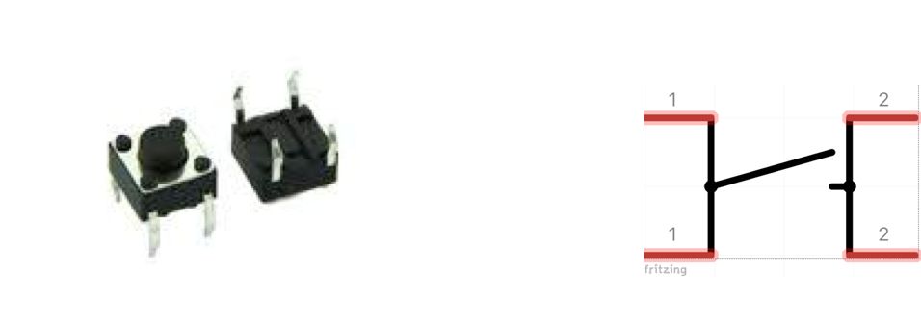
The Momentary Button
Push buttons come in a variety of different shapes and sizes
Momentary buttons alter state only while pressed
Push Buttons are an effective way to receive external input
Push buttons are used on everyday devices such as keyboards, mice, keypads on games consoles and simple on/off buttons
Note how the legs on the buttons face each other facing legs are connected internally
Notes:
When inserting the Pico into the breadboard ensure the usb port is at the top end of the board for ease of inserting the cable Creating a ground and power rail at this stage will make later lesson set up simpler. Here we are using GPIO 14 the second from the bottom on the left side of the Pico you can change this but you need to amend the code.
The ground is the 3rd pin down and the 3v is the 5th pin down it is really important that students do not put the ground and 3v in the same rail as this will create a circuit and the pico will get extremely hot very quickly. With less confident students consider setting up the breadboard with the power rail and ground rail using U shape Jumper wires as a permanent set up.

Slide 9
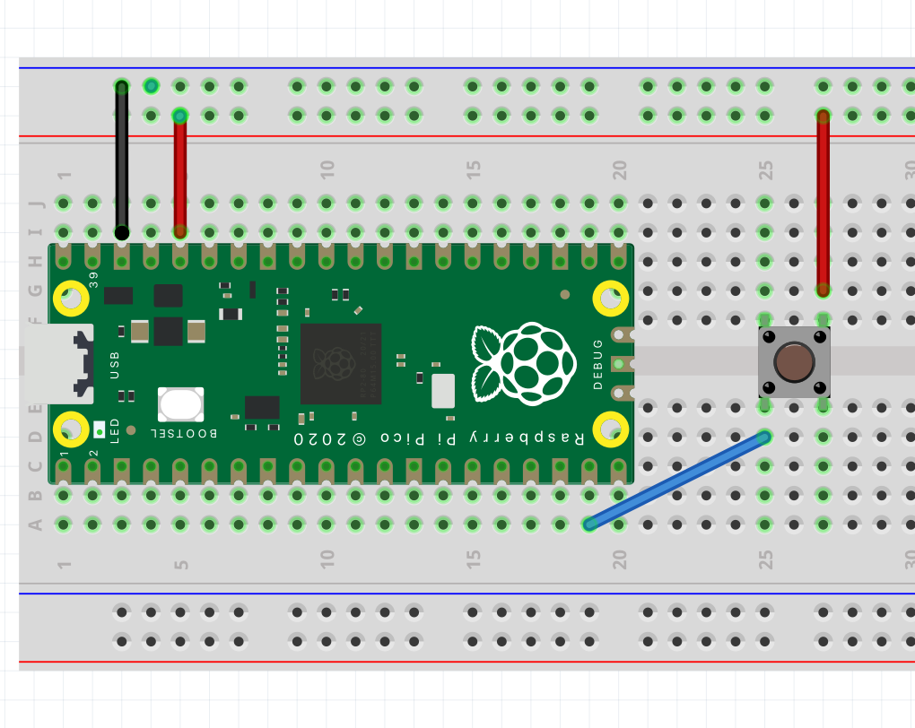
The Circuit
Power Rails
Ground Rails
Button Pin 14
Note how the legs on the button face each other facing legs are connected
3v
Notes:
When inserting the Pico into the breadboard ensure the usb port is at the top end of the board for ease of inserting the cable Creating a ground and power rail at this stage will make later lesson set up simpler. Here we are using GPIO 14 the second from the bottom on the left side of the Pico you can change this but you need to amend the code.
The ground is the 3rd pin down and the 3v is the 5th pin down it is really important that students do not put the ground and 3v in the same rail as this will create a circuit and the pico will get extremely hot very quickly. With less confident students consider setting up the breadboard with the power rail and ground rail using U shape Jumper wires as a permanent set up.

Slide 10
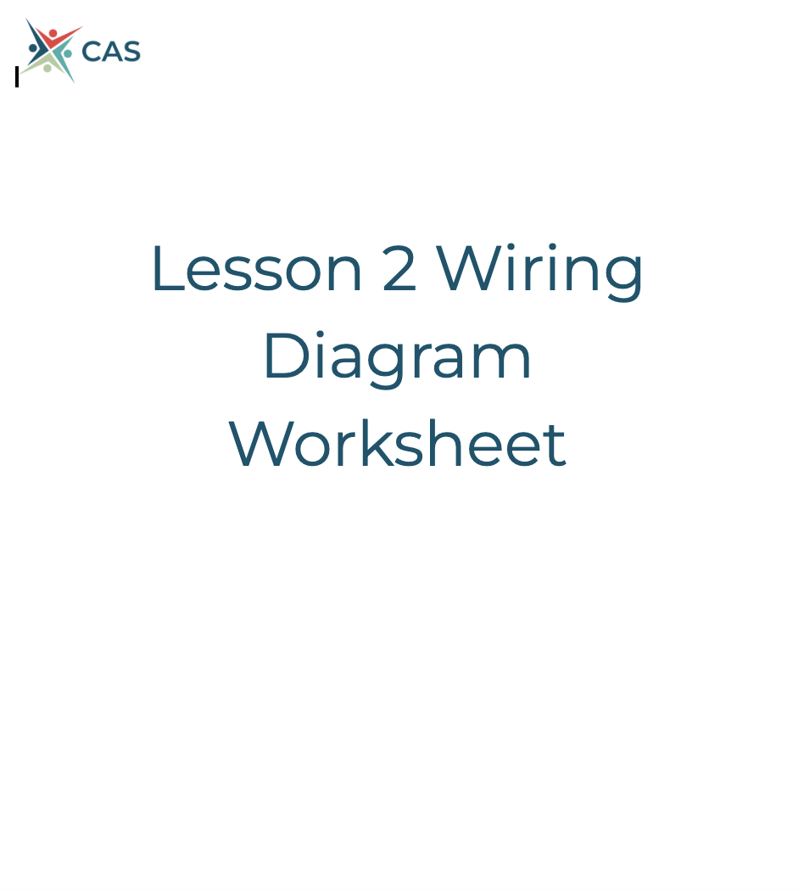
Use the wiring diagram worksheet to complete your circuit

Slide 11

Implement the starter code
Complete the worksheet activity and then try to complete the challenge tasks

Slide 12
Plenary

Slide 13
Explain what is meant by the term debounce?
Notes:
Students can record answers in books etc or they can write on dry wipe boards

Slide 14
Homework
Research the Capacitive Touch Buttons and Toggle Switches.
Which can be used in electronic circuits. Create a slide for each containing an image of the item and an explanation of how they work

